Slide 1

Module - 1 target – 3 BATCH – 5
WEB-TECHNOLOGIES
Topic - File system (node - js)
Reg No:
211FA04579
211FA04602
211FA04614
211FA04624
221LA04004
MODULE-2
BATCH-5

Slide 2


Slide 3
File System
The built-in Node.js file system module helps us store, access, and manage data on our operating system.
The Node.js file system module allows you to work with the file system on your computer . To include the File System module, use the require() method:
var fs = require('fs’);
It allows you to perform various file-related operations, such as reading and writing files, creating directories, and managing file metadata. The "fs" module is part of Node.js's standard library, so you don't need to install any additional packages to use it.

Slide 4

Common use for the File System module:
Read files
Create files
Update files
Delete files
Rename files

Slide 5
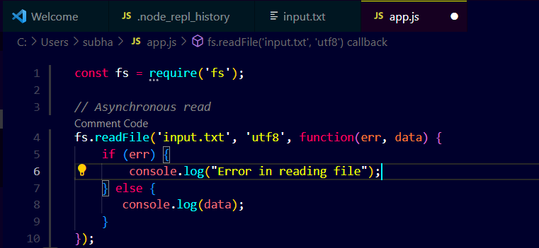
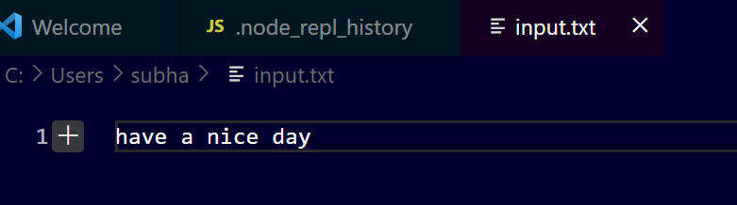
Read File
The simplest way to read a file in Node.js is to use the fs.readFile() method by passing the file path, encoding, and a callback function.

Slide 6
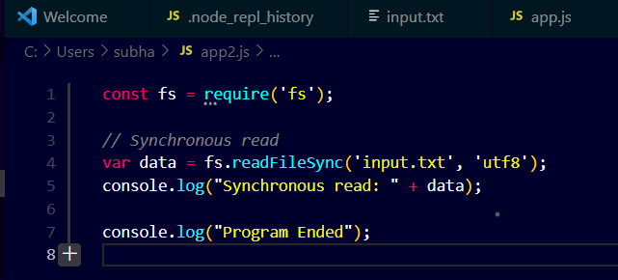
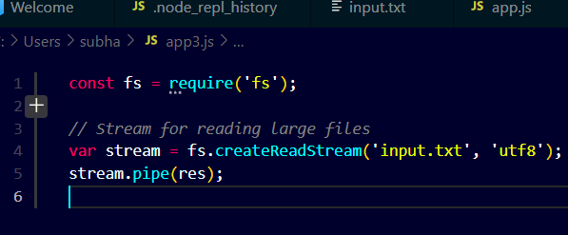
Alternatively, you can use fs.readFileSync() to read the file synchronously& stream read file:

Slide 7
Create File
Creating a file using Node.js is a straightforward process that involves utilizing the built-in 'fs' module.
The 'fs' module provides various methods for interacting with the file system, including creating, reading, writing, and deleting files.
To create a new file using Node.js, you can employ the 'fs.writeFile()' method.
This method takes two arguments: the file path and the content to write to the file.
The file path specifies the location of the file you want to create, while the content can be any string or Buffer object.

Slide 8
Here's an example of how to create a file named 'mynewfile.txt' and write the text 'Hello, world!' to it:
const fs = require('fs');
fs.writeFile('mynewfile.txt', 'Hello, world!', (err) =>
{
if (err) throw err;
console.log('File created successfully!');
});

Slide 9
If you want to create a file synchronously, you can use the 'fs.writeFileSync()' method.
This method takes the same arguments as 'fs.writeFile()' but operates synchronously, meaning it blocks the execution of the code until the file has been created and the content has been written.
const fs = require('fs');
try {
fs.writeFileSync('mynewfile.txt', 'Hello, world!');
console.log('File created successfully!');
} catch (err) {
console.error('Error creating file:', err);
}

Slide 10
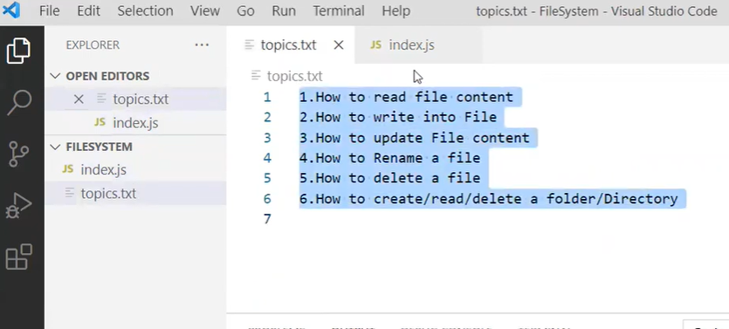
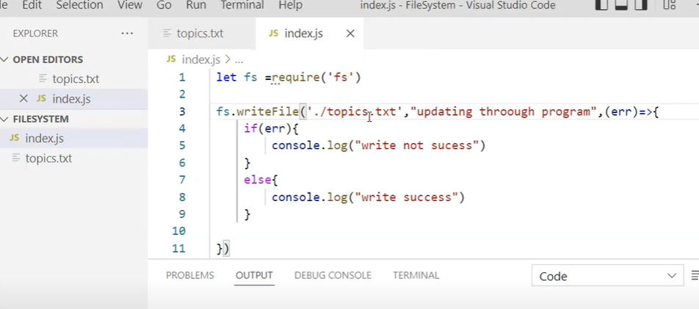
UPDATE:

Slide 11
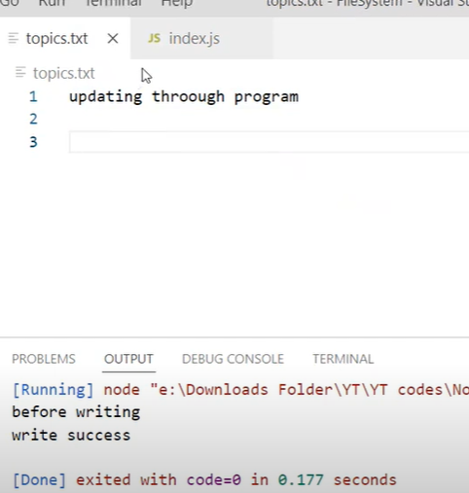
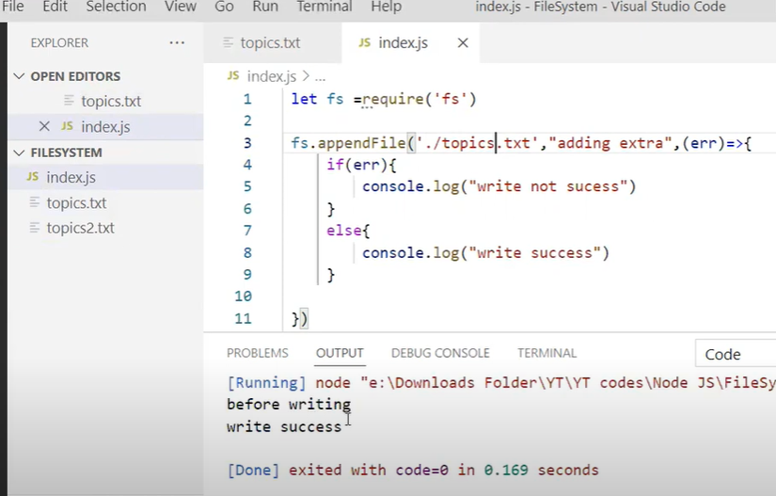

Slide 12
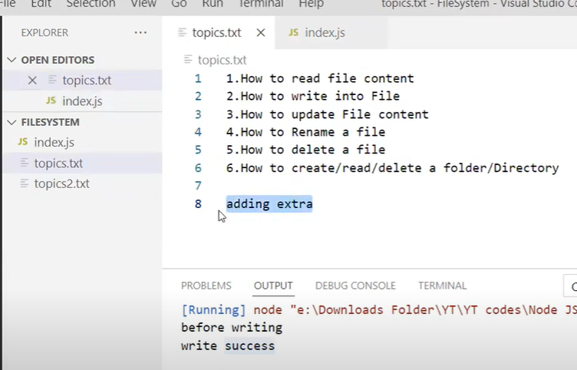

Slide 13
Rename files
1. File System Module (fs):
The fs module is a core module in Node.js that provides functionality to interact with the file system. It includes various methods for performing file-related operations, such as reading, writing, and, in this case, renaming files.
2. fs.rename Method:
The fs.rename method is specifically used for renaming files. It takes three parameters:
oldPath: The current path or name of the file.
newPath: The desired new path or name for the file.
callback: A callback function that is called once the renaming operation is complete. This function typically handles any errors that may occur during the renaming process.
The asynchronous nature of this method ensures that the file renaming process doesn't block the event loop, allowing the application to remain responsive.
3. Error Handling:
The callback function passed to fs.rename is crucial for error handling. If an error occurs during the renaming process, it will be passed to this function as the first parameter. In the provided example, if there's an error, it logs an error message. This step is essential to gracefully handle issues such as permission errors, file not found, or other unexpected problems.

Slide 14
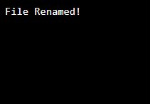
Rename files
In Node.js, you can use the fs module to rename files. Here's a simple example:
const fs = require('fs');
const oldPath = 'oldFileName.txt';
const newPath = 'newFileName.txt';
fs.rename(oldPath, newPath, (err) => {
if (err) {
console.error(`Error renaming file: ${err}`);
} else {
console.log('File renamed successfully!');
}
});
Output:

Slide 15
Delete files
File Deletion Methods
Node.js offers various methods for deleting files, including synchronous and asynchronous options. Understanding the differences and implications of each method is essential for proper f ile management.
Error Handling:
Handling errors during file deletion is critical to prevent data loss and ensure system stability. This slide will cover best practices for errors handling in Node.js file system operations.

Slide 16
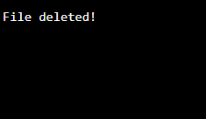
To delete a file with the File System module, use the fs.unlink() method
The fs.unlink() method deletes the specified file:
var fs = require('fs');
//Delete the file mynewfile2.txt:
fs.unlink('mynewfile2.txt', function (err) {
if (err) throw err;
console.log('File deleted!');
});
Output:

Slide 17
Conclusion
File handling in Node. js is an essential component of development since it makes it possible to manipulate files effectively. A complete collection of functions to read, write, update, and delete files are offered by the fs module.

Slide 18


